Slide 1
Power BI - Tutorial

Slide 2

30 Days Data Scinece & Analytics Master Class
Handbook

Slide 3
NANDHINI.S
Exp: 5 Yrs
Expert in
Python Developer on Machine Learning
Deep learning with computer vision
Matlab – Image Processing
Autonomous Car design using ROS with LIDAR
Language – Python , Java , HTML ,CSS.
Tools – ANACONDA NAVIGATOR, JUPYTER NOTEBOOK,
GOOGLE COLAB.
Graduation : BE – ECE | 2011

Slide 4
Pantech?
Educational Equipment Manufacturer
IoT, AI, Robotics,Autonomous Robot
Microprocessor/Microcontroller
DSP,VLSI, Embedded System
Power Electronics & Drives, Fuel Cell Trainer Kit
Renewable Energy Lab, Electric Vehicle Lab
Technical Training
DIY Project

Slide 5

What is Master Class ?
👍 This is the 30 Days Industrial Learning Activity.
👍 Its Online YouTube Live Class
👍 If you Invest 45 minutes daily, U will become Master in Data Science
👍 You will get FREE E-Certificate
Webinar Participation Certificate
“Learning is the beginning of wealth.
Searching & Learning is where the miracle process all begins.” …………….Jim Rohn

Slide 6
Our Vision
Help 10 Million Students to Learn the Technology in Easy Way

Slide 7

Associate Partner for this Master Class
https://apssdc.in/home/

Slide 8
What U will Learn from 30 Days Data Science & Analytics Master Class

Slide 9





Data Science & Analytics Learning Plan
01
02
03
04
05
Library
Python
Analytics
Tools
Industry Project
Introduction To Python and Python Data Structures
Pandas
Numpy
MatplotLib
Cborn, SKLearn Lib
Collab
Distribution
Visualization
Aggregation
Statistics
PowerBi
Tableo
Project Building,
DSA Jobs

Slide 10
Day wise Learning Plan
Day -1 : Python for Data Science (5 Solved end-to-end Data Science Projects in Python)
Day -2: Advanced Python Programming
Day -3: Pandas Library – Introduction
Day -4: Pandas Library – Data Structures
Day -5: Numpy library – Array Operations | Mathematical Functions
Day -6: Numpy – Sort, Search and Counting Functions
Day -7: Matplotlib , Histogram Using Matplotlib | I/O With Numpy
Day -8: Matplotlib Library – Introduction , Pyplot API | Types Of Plots
Day -9: Seaborn Library
Day -10: SKLearn Library
Day -11: Google Colab Notebook
Day -12: Python – Date and Time, Data Wrangling
Day -13: Python – Data Aggregation
Day -14: Python – Word Tokenization , Stemming and Lammetization
Day -15: Python – Data Visualization

Slide 11
Day wise Learning Plan
Day -16: Python – Statistical Analysis
Day -17: Python – Types Of Distribution
Day -18: Python – Correlation ,Chi-Square Test , Linear Regression
Day -19: Tableau – Introduction and Tools
Day -20: Tableau – Data Sources , Worksheets
Day -21: Spatial Data Science For Covid-19 Disease Prediction
Day -22: Power-BI – Introduction, Installation Steps and Architecture
Day -23: Power-BI – Data Modelling , Visualization Options | Excel Integration
Day -24: Parkinson’s Disease Prediction – XG Boost Classifier
Day -25: House Price Prediction using Random Forest Regression
Day -26: Customer Segmentation Using ML – K-Means Clustering
Day -27: Home Loan Prediction using Decision Tree Classifier
Day -28: Spam Classification using NLP
Day -29: Hand Written Digit Recognition Using CNN
Day -30: Churn Prediction using Deep Learning

Slide 12
List of Projects for Demo in YouTube Live
Spatial Data Science For Covid-19 Disease Prediction
Parkinson’s Disease Prediction-XGBoost Classifier
House Price Prediction-Random Forest Regression
Customer Segmentation Using ML-K-Means Clustering
Home Loan Prediction-Decision Tree Classifier
Spam Classification-NLP
Hand Written Digit Recognition Using Python-CNN
Churn Prediction-Deep Learning
Crop Yield Prediction
Ground water level prediction
All Projects in Jupyter Notebook

Slide 13
What you will get from this Free 30 Days Master Class?
You can attend YouTube Live Class
Free E-Certificate ( WEBINAR PARTICIPATION CERTIFICATE)

Slide 14
How to mark your Attendance in YouTube Live Class?
Ans : During the Live Class, organizer will post Google Form link in Live Chat. The Participants should submit the from on daily basis. Minimum 25 Days Attendance is Required to get Free Master Class Participation Certificate.
Note : The Link will be available during the Live. From the LIVE Class date, the live video will get removed from the YouTube in 3 days.

Slide 15


Sample Webinar Participation Certificate?

Slide 16
https://www.pantechelearning.com/data-science-master-class/
On Demand
You can get chance to apply 1 Month Internship on Data Science & Analytics Master Class

Slide 17
What is Internship????
Learn
Practice
Verify
Get Certified
Grow

Slide 18
Free Master Class DSA | 1 Month Internship on DSA
Master Class Participation Certificate | Internship Completion Certificate
Minimum 25 Class should attend YouTube Live | Recorded Class Link will be provided. – LMS Portal Access
YouTube Live Mandatory | Your Choice. You can attend Live or else You can watch Recorded Class in LMS Portal
All Projects Demo class in YouTube Live | Step by Step Video Explanation Content in LMS Portal
Access : 3 Days | VIP WhatsApp Group Support
 | You Can Download All PPTs
 | 4 Nos of Hackathon Class in Zoom Live. The Recording also will be provided
 | You Can Download All Project Files
 | Mentor will guide you to finish 10 Projects
 | Access : 60 Days

Slide 19
Pantech will make you to Create 10 Projects in Data Science & Analytics in 30 Days
Objective of this 30 Days Master Class

Slide 20
1 Month Internship in Data Science
INTERNSHIP E-Certificate(30Days Internship on Data Science Engineering)
Highly organized Video content
Download All Files
Download PPTs
Assignments
Flexible Time.
Access Period: 60Days from the date of payment

Slide 21
What You Will Get???
Complete Project Files
30 Days Learning Activity
Data Science Core Concepts
10 + Projects
Project PPT
Spatial Data Science For Covid-19 Disease Prediction
Parkinson’s Disease Prediction-XGBoost Classifier
House Price Prediction-Random Forest Regression
Customer Segmentation Using ML-K-Means Clustering
Home Loan Prediction-Decision Tree Classifier
Spam Classification-NLP
Hand Written Digit Recognition Using Python-CNN
Churn Prediction-Deep Learning
Crop Yield Prediction
Ground water level prediction
Video Class Access for 2 Months
Get chance to Enroll 1-Month Internship on demand

Slide 22

How to join in 1 month Internship
https://www.pantechelearning.com/data-science-master-class/
Click Here
Coupon Code: DSABATCH4

Slide 23


Slide 24
Power BI - Introduction
It is a data visualization and Business Intelligence tool that converts data from different data sources to BI reports.
Power BI suite provides multiple software , connector and services – Power BI Desktop , Power BI service based on SaaS , and mobile power BI apps available for different platforms.
These set of services are used by business users to consume data and build BI reports.

Slide 25
Pre - Requisites
Microsoft Excel.
Data Modeling.
Knowledge of DAX language.

Slide 26
Power BI – Installation Steps
To check the system requirements , installation files detail, users have to navigate to “Advanced download options”.
Supporting Operating Systems:
Windows 10 , Windows 7 , Windows 8.
Microsoft Power BI Desktop requires Internet Explorer 9 or higher.
Microsoft Power BI Desktop is available for 32-bit(*86) and 64-bit(*64) platforms.

Slide 27
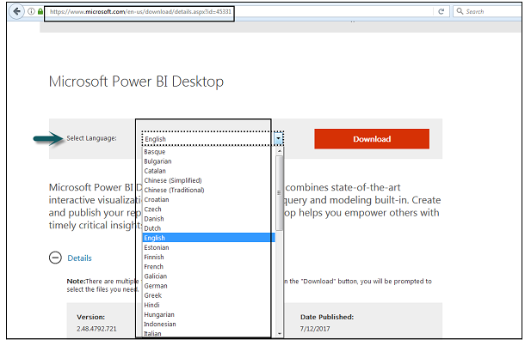
Power BI – Installation Steps

Slide 28
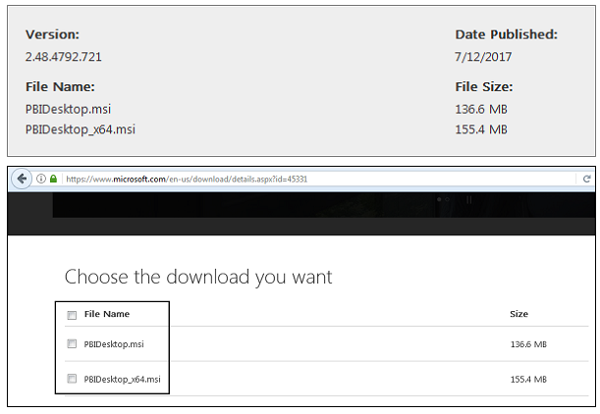
Power BI – Installation Steps
This is the link to directly download Power BI files:
https://www.microsoft.com/en-us/download/details.aspx?id=45331.

Slide 29
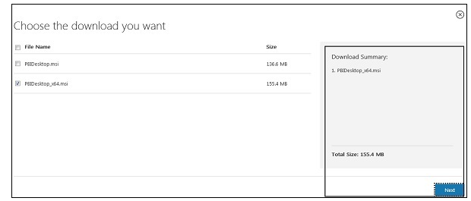
Power BI – Installation Steps
PBIDesktop_x64.msi shows a 64-bit OS file. Select the file you want to install as per OS type and click Next. Save the installation file on the local drive.

Slide 30
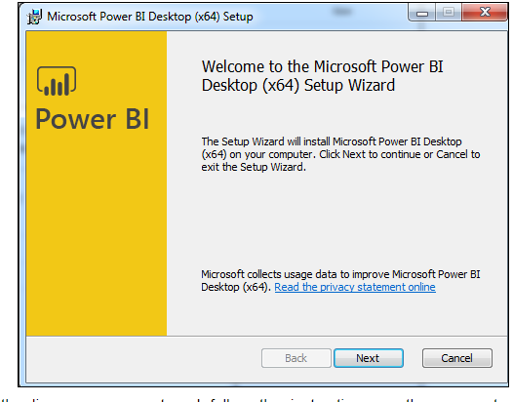
Power BI – Installation Steps
When we run the installation file , the following screen will be displayed.

Slide 31
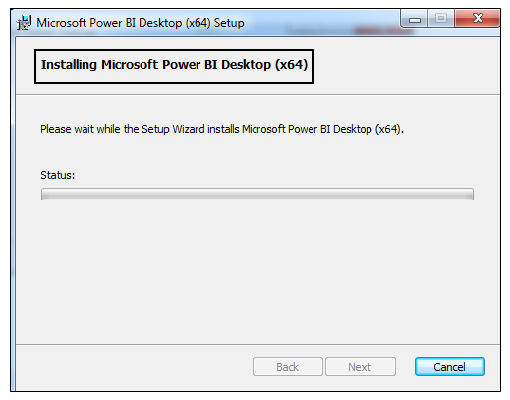
Power BI – Installation Steps
Accept the licence agreement and follow the instructions on the screen to finish the installation:

Slide 32
Power BI – Installation Steps
When powerBI is installed , it launches a welcome screen.
This screen is used to launch different options related to get data , enrich the existing data models , create reports as well as publish and share reports.

Slide 33
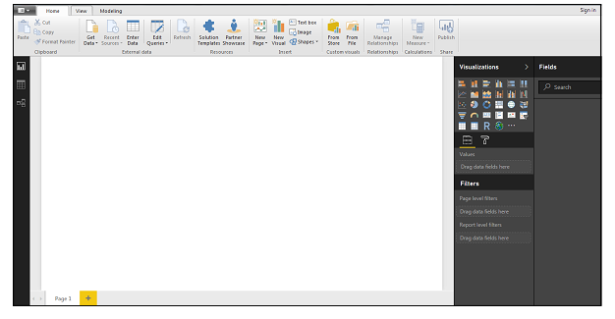
Power BI – Installation Steps

Slide 34
Power BI - Architecture
It includes the following components:
Power BI Desktop : It is used to create reports and data visualizations on the dataset.
Power BI Gateway: We can use the power BI on – premises gateway to keep the data fresh by connecting to on –premises data sources without the need to move the data.
It allows us to query large datasets.

Slide 35
Power BI - Architecture
Power BI Mobile Apps:
Using power BI mobile apps , we can stay connected to their data from anywhere.
Power BI apps are available for windows , Ios and Android platform.
Power BI Service:
This is a cloud service and is used to publish Power BI reports and data visualizations.

Slide 36
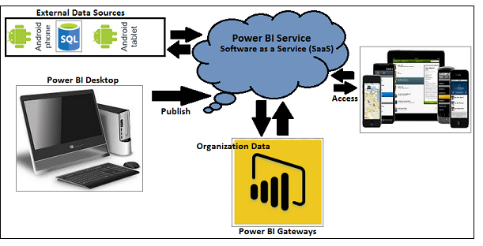
Power BI - Architecture

Slide 37
Power BI – Data Modelling
Using Data Modelling and Navigation:
Data modelling is one of the features used to connect multiple data sources in BI tool using a relationship.
A relationship defines how data sources are connected with each other and we can create interesting data visualizations on multiple data sources.
With the modelling feature , we can build custom calculations on the existing tables and these columns can be directly presented into power BI visualizations.

Slide 38
Power BI – Data Modelling
The above image shows a common data model which shows the relationship between two tables.
Both the tables are joined using a column name “Id”.
In Power BI , we set a relationship between two objects.
To set the relationship , we have to set a drag a line between two columns.
We can also view the “Relationship” in a data model in Power BI.

Slide 39
Power BI – Data Modelling
To create data model in power BI , we need to add all data sources in Power BI new report option.
To add a data source, go to the Get Data option.
Then , select the data source we want to connect and click the Connect button.

Slide 40
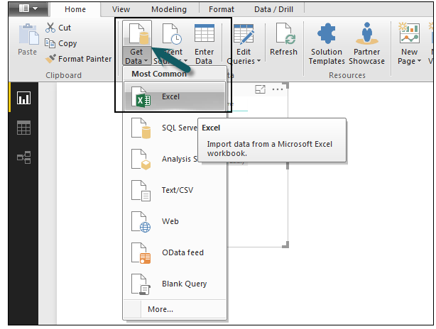
Power BI – Data Modelling

Slide 41
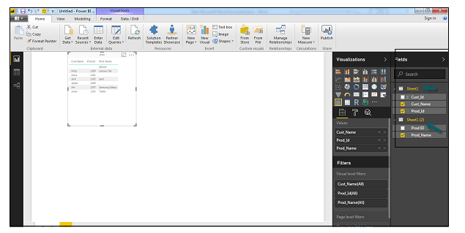
Power BI – Data Modelling
Once we add a data source , it is added on the right side bar.
In the following image , we have used 2 xls file to import data – Customer and Product.

Slide 42
Power BI – Data Modelling
In power BI on the left side , we have the following tabs:
Report
Data
Relationships.

Slide 43
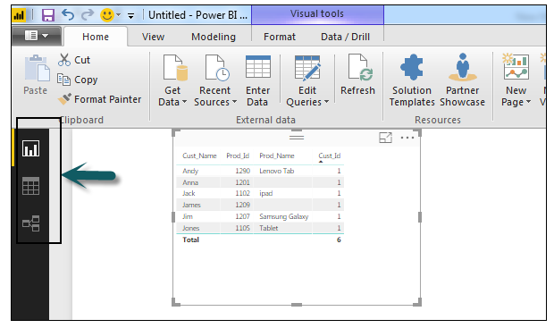
Power BI – Data Modelling

Slide 44
Power BI – Data Modelling
When we navigate to the report tab , we can see a dashboard and a chart selected for data visualization.
We can select diffferent chart types as per our need.
Select a table type from available visualizations.

Slide 45
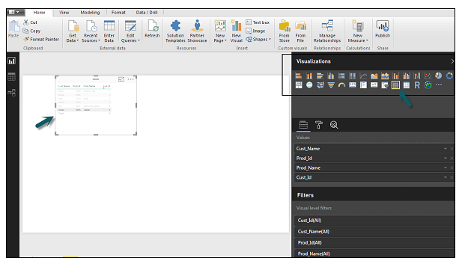
Power BI – Data Modelling

Slide 46
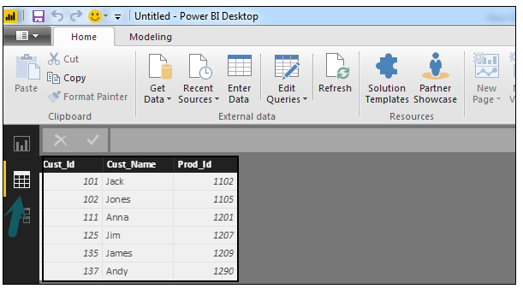
Power BI – Data Modelling
When we go to the data tab, we can see all the data as per the defined relationship from the data sources.

Slide 47
Power BI – Data Modelling
In the relationship tab , we can see the relationship between the data sources.
When we add multiple data sources to the power BI visualization , the tool automatically tries to detect the relationship between the columns.
When we navigate to the Relationship tab , we can view the relationship.
We can also create a relationship between the columns using Create Relationships option.

Slide 48
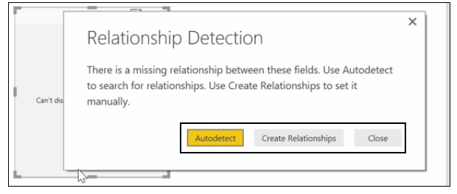
Power BI – Data Modelling

Slide 49
Power BI – Data Modelling
We can also add and remove relationships in data visualization.
To remove a relationship , we need to right-click and select the “Delete” option.
To create a new “Relationship”, we just need to drag and drop the fields that we want to link between the data sources.

Slide 50
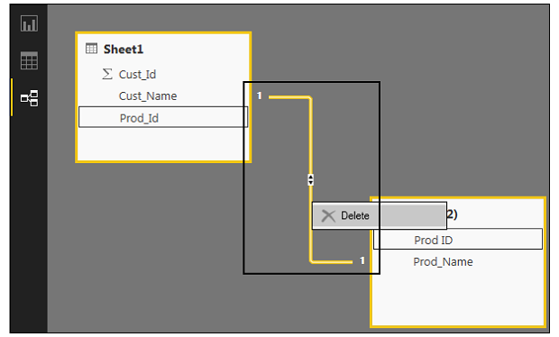
Power BI – Data Modelling

Slide 51
Power BI – Data Modelling
We can also view the Relationship view to hide a particular column in the report.
To hide a column , right – click on the column name and select the “Hide in report view” option.

Slide 52
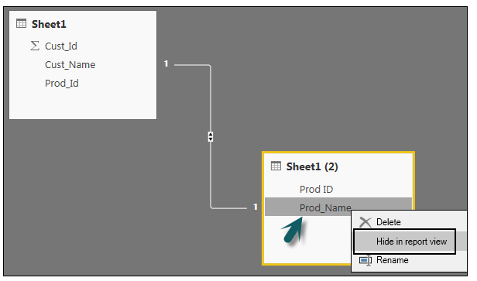
Power BI – Data Modelling

Slide 53
Power BI – Data Modelling
Creating Calculated Columns:
We can create calculated columns in Power BI by combining two or more elements of the existing data.
Apply calculation on an existing column to define a new metric.
Combine two columns to create one new column.
We can even create a calculated column to establish a relationship between the tables .
It can also be used to setup a relationship between two tables.
To create a new calculated column , navigate the data view tab on the left side of screen and then click Modeling.

Slide 54
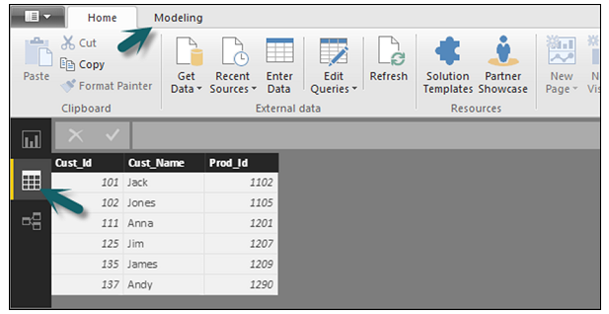
Power BI – Data Modelling

Slide 55
Power BI – Data Modelling
When we navigate to the Modeling tab , we can see a new column option at the top of the screen.
It opens a formula bar , where we can enter DAX formula to perform calculation.
DAX – Data Analysis Expression is a powerful language also used in Excel to perform calculations.
We can also rename the column by changing the Column text in the formula bar.

Slide 56
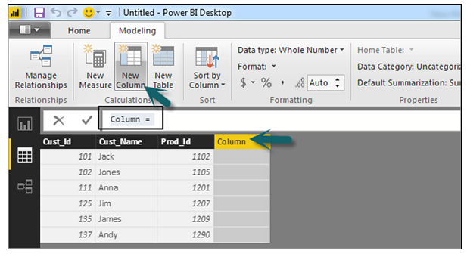
Power BI – Data Modelling

Slide 57
Power BI – Data Modelling
In the following example, let us create a new column: Product Code (Product_C), which is derived from the last three characters of Prod_Id column. Then, write the following formula −
Product_C = RIGHT( Sheet1[Prod_Id],3)

Slide 58
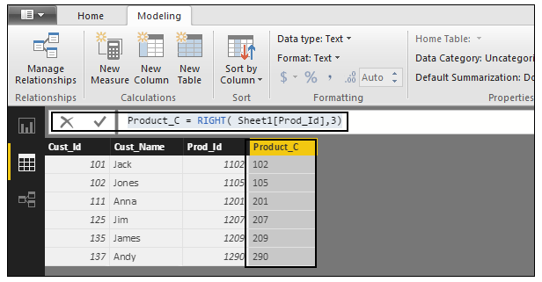
Power BI – Data Modelling

Slide 59
Power BI – Data Modelling
A long list of formulas is also provided that we can use for creating calculated columns.
We have to enter the first character of formula to be used in calculations.

Slide 60
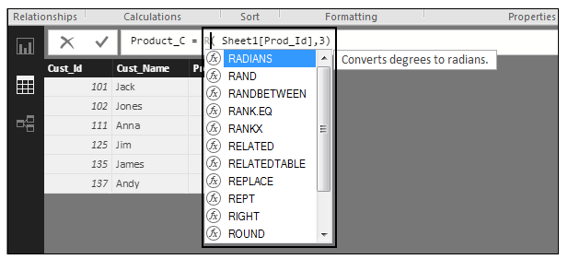
Power BI – Data Modelling

Slide 61
Power BI – Data Modelling
Creating Calculated Tables:
We can also create a new calculated table in data modelling in Power BI.
To create a new table , navigate to the Data view tab on the left side of the screen .

Slide 62
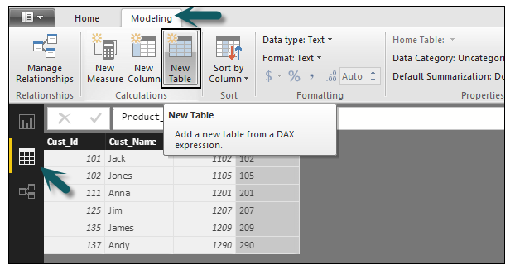
Power BI – Data Modelling

Slide 63
Power BI – Data Modelling
DAX expression is used to create the new table.
We have to enter the name of a new table on the left side of the equal sign and DAX formula to perform the calculation to form that table on the right.
When the calculation is completed , the new table appears in the Fields pane in the model.

Slide 64
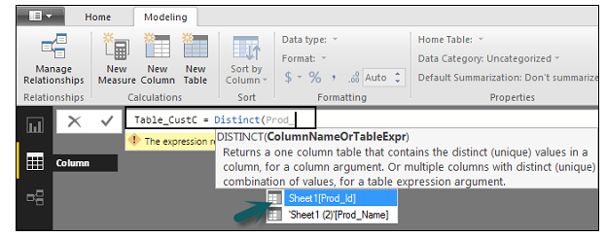
Power BI – Data Modelling
In the following example , define a new table – Table_CustC that returns a one column table containing unique values in a column in another table.

Slide 65
Power BI – Data Modelling
A new table is added under the “Fields” section in Power BI screen as shown in the following screenshot.
Once the calculated column and calculated tables are created as per the requirement , we can use the fields in the Report tab in the Power BI.
To add these objects , we have to select a checkbox and a relationship is automatically detected if possible.
If not , then we can drag the columns that we want to connect.

Slide 66
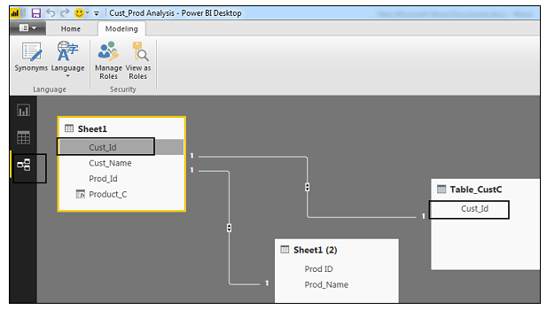
Power BI – Data Modelling

Slide 67
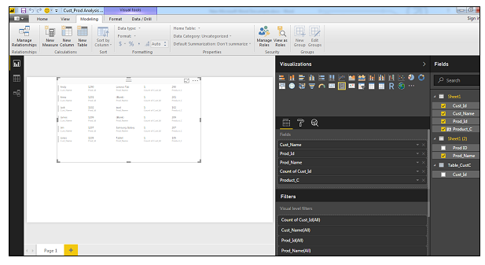
Power BI – Data Modelling
To view the report ,we navigate to the report tab and we can see both “Calculated Columns” and fileds from the new “Calculated table” in the report view.

Slide 68
Managing Time Based Data
Power BI allows to drill through time – based data by default.
When we add a data field in the analysis and enable drill on our data visualization , it takes you to the next – level of time – based data.
Time – Based table has been added in the Power BI Visualization.
Revenue and Year column has been added in the report.

Slide 69
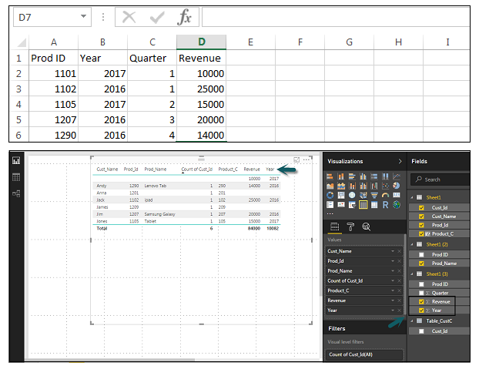
Managing Time Based Data

Slide 70
Managing Time Based Data
We can enable the drill feature in visualizations using the option at the top.
Once we enable the drill feature and click the bars in the chart , it drills down to the next level of hierarchy.
Eg: Years-> Quarters-> Months.
We can also use Go To the Next Level in the hierarchy option to perform a Drill.

Slide 71
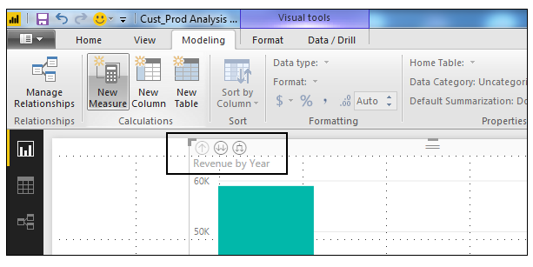
Managing Time Based Data

Slide 72
Power BI – Dashboard Options
Exploring Different Datasets:
Power BI tool provides a lot of options to explore the datasets.
When we are working on the BI report , we can use Power BI look for quick insights.
Navigate to the datasets section on the left side of the tool UI , click the 3 dots(…) and click Get Insights.

Slide 73
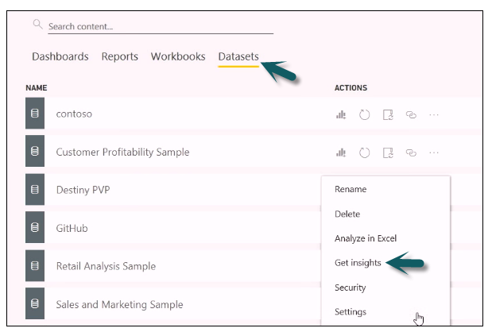
Power BI – Dashboard Options

Slide 74
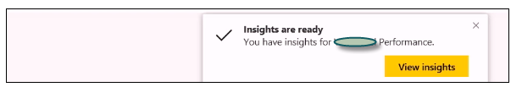
Power BI – Dashboard Options
When we select the Get Insights option , it runs all the algorithms in our dataset and once it is completed , we get a notification that insight is ready for our dataset.

Slide 75
Power BI – Dashboard Options
We can click the view insights option .
The tool will show all chart representations of the data insights.
We can go to this option anytime and check insights option in the dataset.
When we publish a report to Power BI service , we also get an option of
Quick insight on the first page.

Slide 76
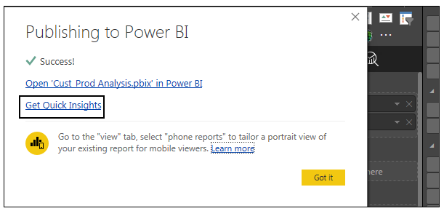
Power BI – Dashboard Options

Slide 77
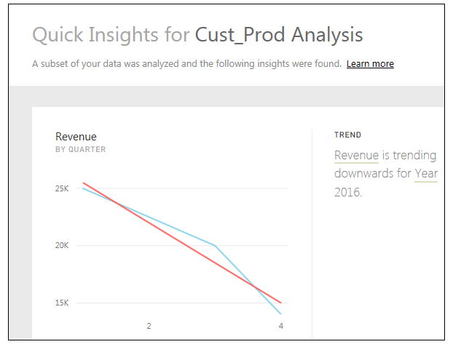
Power BI – Dashboard Options

Slide 78
Power BI – Dashboard Options
Creating Dashboards:
In power BI , we can create a dashboard by pinning visualizations from BI reports that are published using Power BI desktop.
All the visualizations that are created using Power BI service are also available for pinning.
In Power BI , if we want to pin a visual , open the BI report on the Power BI service.
At the top of the visual , select the pin icon.

Slide 79
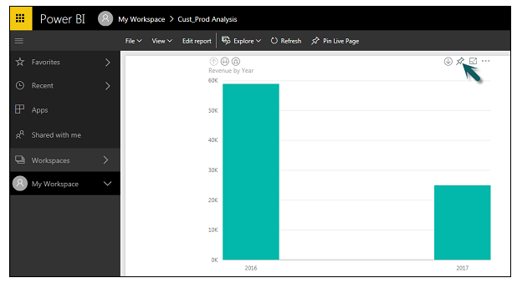
Power BI – Dashboard Options

Slide 80
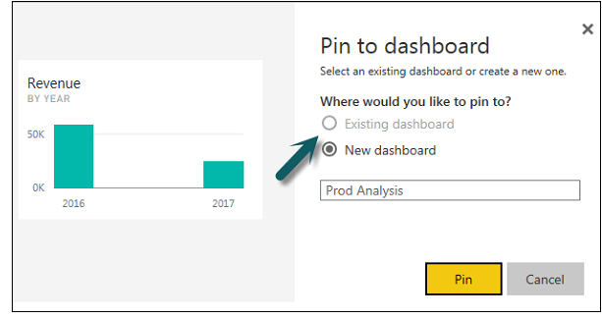
Power BI – Dashboard Options
When we use the pin option, a new dialog box appears.
It asks us to create a new dashboard or select an existing dashboard to put the visual from the dropdown list.
If we don’t have an existing dashboard , then this option is greyed out.

Slide 81
Power BI – Dashboard Options
Once we click the pin button , we will get a confirmation that our visualization is “Pinned to the dashboard”.
We can click My Workspace and check the dashboard.
Once the dashboard is created , we can use different options to configure the dashboard.

Slide 82
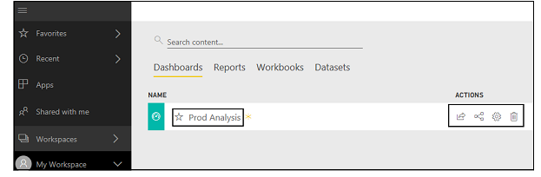
Power BI – Dashboard Options

Slide 83
Power BI – Dashboard Options
Sharing Dashboards:
When we publish our BI report to the Power BI service , we can share reports and dashboards with other users in the organization.
Sharing a dashboard is very easy in Power BI.
We have to open the dashboard in the Power BI service and click the share option at the top right corner of the screen.

Slide 84
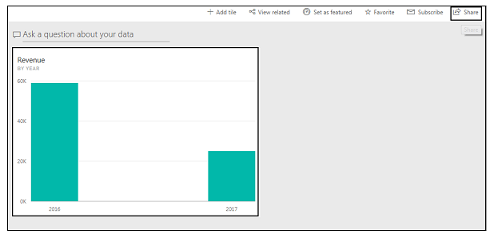
Power BI – Dashboard Options

Slide 85
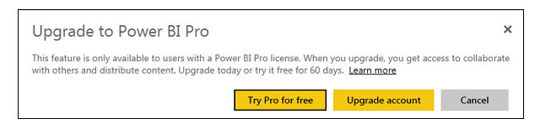
Power BI – Dashboard Options
The sharing feature is available only with Power BI Pro version.
We can also use the 60 – days free trial for Power BI Pro as shown in the following screenshot.

Slide 86
Power BI – Dashboard Options
Click the try pro for free to start a trial.
Select the start trial and Finish , we will get a confirmation that 60 – days trial has started.
When we click the Share Dashboard , we will get the options in the new window.
We have to enter the email Id of the user with whom we want to share the dashboard.
We can allow the recipients to share the dashboard with other users or send email notifications.
We can also provide the direct URL to the users and they can access the dashboard directly.

Slide 87
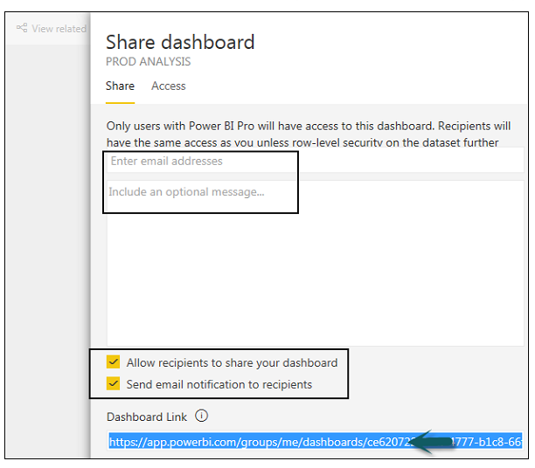
Power BI – Dashboard Options

Slide 88
Power BI – Dashboard Options
Tiles in Dashboard:
When we check more options in the dashboard , we can see an option of focus mode and other different options in the dashboard.
Focus mode is used to take a closer look at the dashboard data.
When we have multiple values in the dashboard , we can use the Focus mode for better view of objects in the dashboard.
If there are any columns , we can also view those using the focus mode.

Slide 89
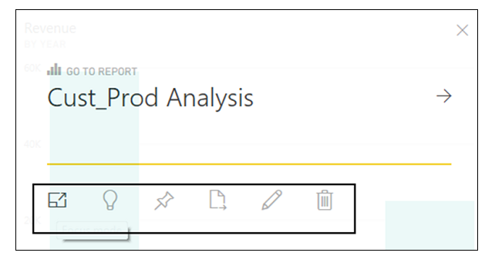
Power BI – Dashboard Options

Slide 90

Power BI – Dashboard Options
Focus mode is used to see all the data in the dashboard/report.
It is also possible to pin the visual directly from the Focus Mode to a different dashboard.
To exit the Focus Mode , we can select the Exit Focus Mode option.

Slide 91
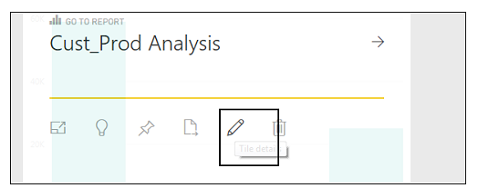
Power BI – Dashboard Options
We can also use the Tile Details option to edit few formatting changes.
This option allows to change the tile’s title , subtitle , last refresh time and date , and other details such as creating a custom link for our dashboard.

Slide 92
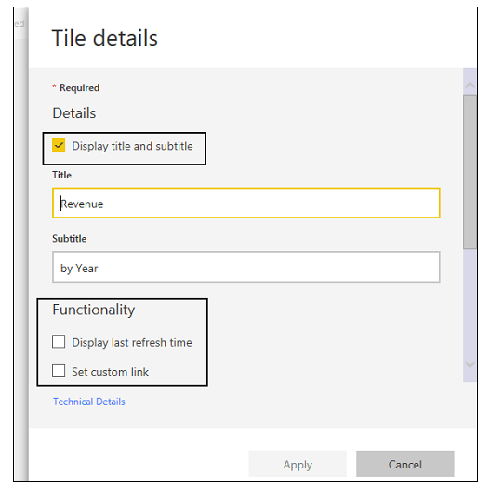
Power BI – Dashboard Options

Slide 93
Power BI – Dashboard Options
Data Gateway:
We can connect on-premise data sources to Power BI service using a data gateway.
We can also use a version of data gateway that doesn’t include any administration configuration and it is called as Personal gateway.
We can set up Personal gateway by logging into Power BI service.
Select the download icon on the top right hand corner of the screen and click Data Gateway.

Slide 94
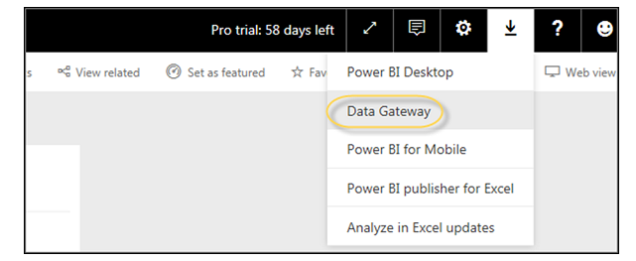
Power BI – Dashboard Options

Slide 95
Power BI – Dashboard Options
As per Power BI official site , using Data Gateway with the on – premises gateways , we can keep our data fresh by connecting to the on – premises data sources without the need to move the data.
Query large datasets and benefit from the existing investments.
The gateways provide the flexibility we need to meet the individual needs , and the needs of the organization.

Slide 96
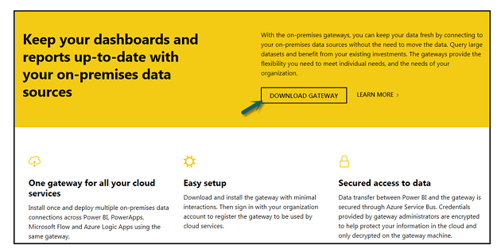
Power BI – Dashboard Options

Slide 97
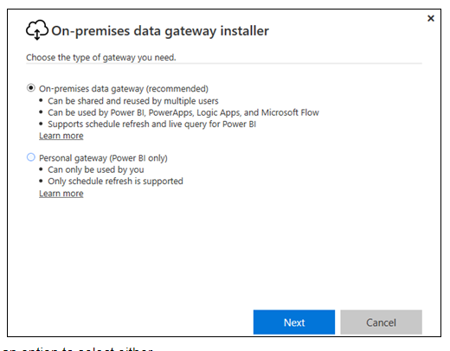
Power BI – Dashboard Options
To set up the download gateways , we have to run the setup till it is downloaded and the installation wizard is completed.

Slide 98
Power BI – Dashboard Options
We have an option to select either:
On – Premise data gateway or
Personal gateway(Power BI only)
Once you launch Power BI gateway , we have to login to Power BI gateway service.
We can also enable automatic updates by navigating to Schedule Refresh and frequency of the schedule.

Slide 99
Power BI – Visualization Options
Creating Simple Visualizations:
Visualizations are used to effectively build our data .
They are the basic building blocks of any Business Intelligence Tool.
Power BI contains various data visualization components.
They include simple bar charts to pie charts to maps .
They also contain complex models like waterfalls , funnels , gauges and
Many other components.

Slide 100
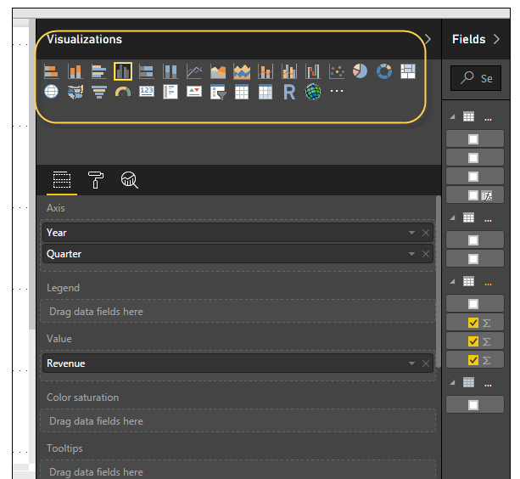
Power BI – Visualization Options

Slide 101
Power BI – Visualization Options
In Power BI , we can create visualization in two ways.
First is by adding from the right side pane to Report Canvas.
By default , it is the table type visualization , which is selected in Power BI.
Anther way is to drag the fields from the right side bar to the axis and the value axis under visualization.
Multiple fields can be added to each axis as per the visualization.

Slide 102
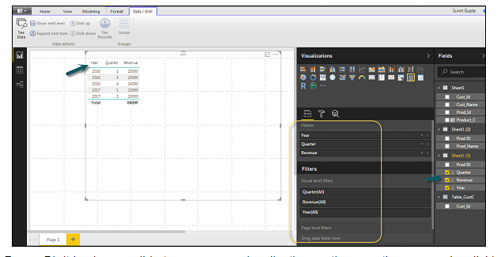
Power BI – Visualization Options
We can add multiple fields to each axis as per the requirement.

Slide 103
Power BI – Visualization Options
In Power BI , it is possible to move the visualization on the reporting canvas by clicking and dragging it.
We can also switch between different types of charts and visualizations from the visualization pane.
Power BI attempts to convert the selected fields to the new visual type as closely as possible.

Slide 104
Power BI – Visualization Options
Creating Map Visualizations:
In Power BI , there are two types of map visualization – bubble maps and shape maps.
If we want to create a bubble map , select the map option from the visualization pane.

Slide 105
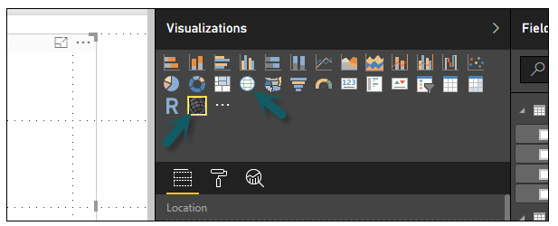
Power BI – Visualization Options

Slide 106
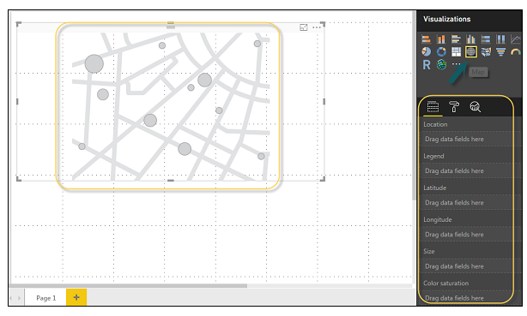
Power BI – Visualization Options
To use a bubble map , drag the map from Visualizations to the report Canvas.
To display values , we have to add any location object to the axis.

Slide 107
Power BI – Visualization Options
In the value fields , we can see that it accepts values axis such as City and State .
We can also add latitude or longitude values.
To change the bubble size , we need to add a field to the value axis.
We can also add a filled map in data visualization , just by dragging the filled map to the Report Canvas.

Slide 108
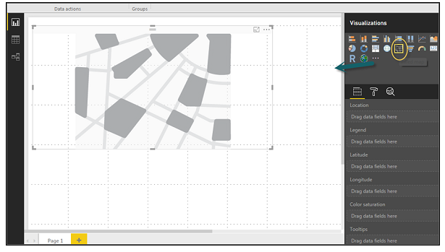
Power BI – Visualization Options

Slide 109
Power BI – Visualization Options
Note: If we see a warning symbol on top of our map visualization , it means that we need to add more locations to our map chart.

Slide 110
Power BI – Visualization Options
Using Combination Charts:
In data visualization , it is also required to plot multiple measures in a single chart.
Power BI supports various combination chart types to plot measure values.
Let us say we want to plot revenue and unit_solds in one chart.
Combination charts are the most suitable option for these kind of requirement.

Slide 111
Power BI – Visualization Options
One of the most common Combination chart in Power BI is Line and Stacked Column charts.
Let us say that we have a revenue field .
We have added a new data source that contains customer – wise unit quantity and we want to plot this in our visualization.

Slide 112
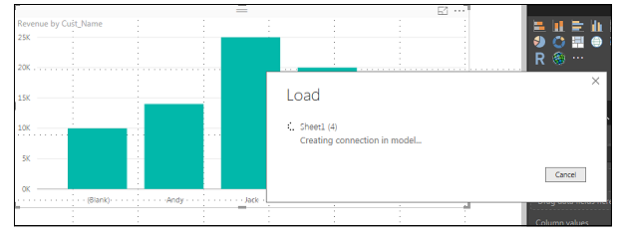
Power BI – Visualization Options

Slide 113
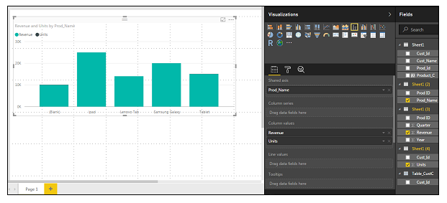
Power BI – Visualization Options
Once we add a data source , it will be added to the list of fields on the right side.
We can add units to the column axis as shown in the following screenshot.

Slide 114
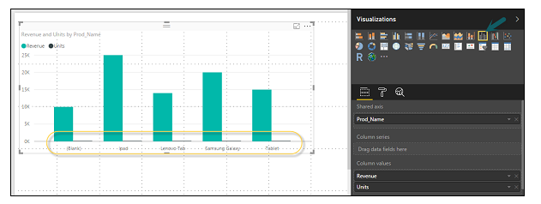
Power BI – Visualization Options
We have other type of combine chart that we can use in power BI – Line and clustered column.

Slide 115
Power BI – Visualization Options
Using Tables:
In Power BI , when we add a dataset too the visualization , it adds a table chart to the report canvas.
We can drag the fields that we want to add to the report.
We can also select the checkbox in front of each field to add those to the Report area.
With the numerical values in the table , we can see a sum of values at the bottom.

Slide 116
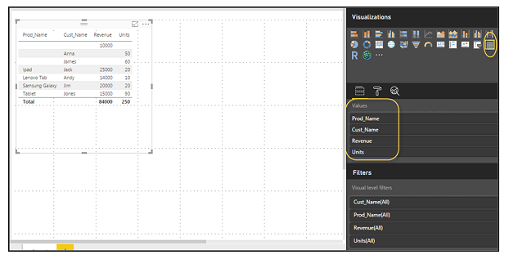
Power BI – Visualization Options

Slide 117

Power BI – Visualization Options
We can also perform a sort in the table using an arrow key at the top of the column.
To perform ascending/descending sort , click the arrow mark and the values in the column will be sorted.

Slide 118
Power BI – Visualization Options
The order of the columns in the table is determined by the order in the value bucket on the right side.
If we want to change the order , we can delete any column and add the other one.

Slide 119

Power BI – Visualization Options

Slide 120
Power BI – Visualization Options
We can also undo summarize or apply different aggregate functions on the numerical values in the table.
To change the aggregation type , click the arrow in the value bucket in front of the measure .
A list of formulas will be displayed that can be used.

Slide 121

Power BI – Visualization Options

Slide 122

Power BI – Visualization Options
Another table type in Power BI is the matrix table .
It provides a lot of features suach as auto sizing , column tables , and setting colours,etc.

Slide 123
Power BI – Visualization Options
Modify Colours In Charts:
In Power BI , we can also modify the colours in chart.
When we select any visualization , it has an option to change the colour.
Following options are available under the Format tab-
Legend
Data Colours
Detail Label
Title

Slide 124
Power BI – Visualization Options
Modify Colours In Charts:
Background
Lock Aspect
Border
General

Slide 125

Power BI – Visualization Options
To open these options ,go to the Format tab as shown in the following
Screenshot.
Once we click , we can see all the options available.

Slide 126
Power BI – Visualization Options
When we expand the legend field, we have an option where we want to display the legend field.
We can select-
Position
Title
Legend Name
Color
Text Size
Font Family

Slide 127

Power BI – Visualization Options

Slide 128
Power BI – Visualization Options
Similarly , we have data colours.
If we want to change the colour of any data field , we can use this option.
It shows all the objects and the corresponding colours in the chart.

Slide 129

Power BI – Visualization Options

Slide 130
Power BI – Visualization Options
We also have analytics feature in the tool.
We can draw lines as per the requirement in data visualization.
Constant line.
Min line.
Max line.
Average line.
Median line.
Percentile line.

Slide 131

Power BI – Visualization Options

Slide 132

Power BI – Visualization Options
We can opt for a dashed , dotted or a solid line.
We can select the transparency level , color and position of the line.
We can also switch on/off data label for this line.

Slide 133
Power BI – Visualization Options
Adding Shapes, Images and Text Box:
It is required that we need to add static text , images or shapes to our visualization.
If we want to add header/footer or any static signatures , messages to data visualization this option can be used.
We can also add URLs in the text box and Power BI uses those links to make it live.
To add shapes, images and text box, navigate to the Home tab and at the top , we will find an option to add images.

Slide 134

Power BI – Visualization Options

Slide 135

Power BI – Visualization Options
We can insert different shapes in data visualization.
To see the available shapes , click the arrow next to the Shapes button.

Slide 136

Power BI – Visualization Options
When we click on the text box, it adds a text box in the Report Canvas.
Any text can be entered in the text box and use the rich text editor to make formatting changes.

Slide 137
Power BI – Visualization Options
Images can be added to data visualization to add logos or other images to data visualization.
When we click the image option , it asks for a path to pass the image file.
We can add shapes by selecting any shape from the dropdown list.
We can also resize it using different options.

Slide 138

Power BI – Visualization Options

Slide 139
Power BI – Visualization Options
Styling Reports:
In Power BI , we have flexible options to adjust the page layout and formatting such as orientation and page size of the report.
Navigate to Page view menu from the Home tab and we will get the following options:
Fit to Page.
Fit to Width.
Actual Size.

Slide 140

Power BI – Visualization Options

Slide 141
Power BI – Visualization Options
By default , page size in a report is 16:9.
It is also possible to change the page size of the report.
To change the page size , navigate to the Visualization pane and select Paint brush.
Note : To change the page size , no visualization should be added to th e Report canvas.

Slide 142
Power BI – Visualization Options
Note:
We have the following options available under page layout:
Page Information.
Page Size.
Page Background.
Under page information , we have Name and Q and A.

Slide 143
Power BI – Visualization Options
Under Page size , we can select from the following options:
Type
Width
Height

Slide 144

Power BI – Visualization Options

Slide 145

Power BI – Visualization Options
Under Page Background , we can select from the following options:
Color
Transparency
Add Image

Slide 146
Power BI – Visualization Options
Duplicating Reports:
We may want to use the same layout and visuals for different pages.
Power BI provides an option to create a copy of the page.
When you use duplicate option , a new page is added with similar layout and visuals.
To duplicate a page , right-click the page and select Duplicate Page option.
This will create a copy of the same page with the name – Duplicate of Page 1.

Slide 147

Power BI – Visualization Options

Slide 148
Power BI – Visualization Options

